Slide 1



MidReview
Optimizing Autonomous Traffic Navigation via Reinforcement Learning and Basal Ganglia Gating in ROS 2
Team Number: 04
Guide: Dr. Divya Udayan J
AM.AI.U4AID23042 — Harita Aneesh
AM.AI.U4AID23059 — Sheron George

Slide 2
AGENDA
What We'll Cover
01
Background & Context
02
Problem Statement
Bridging the Sim-to-Real Reality Gap
Why Roundabouts Break Conventional RL
03
Literature Review
04
Research Gaps & Questions
Core research questions
Foundational literature examined in depth
05
Methodology
06
Recent Progress
Architecture, spatial encoding, actor-critic, reward design
Environment upgrades & Sim-to-Real robustness testing
07
Phase 1 Results
08
PPO learning trajectory, policy collapse, behavioral anomalies
Status & Next Steps
Current status, transition to Phase 2(SAC), references
2

Slide 3
BACKGROUND & CONTEXT
Bridging the Sim-to-Real Reality Gap
Un-signalized and signalized roundabouts, and congested merging ramps, remain one of the hardest environments for autonomous navigation. Traditional Deep RL agents ingest raw, high-dimensional coordinate data — and that choice
alone creates four compounding problems:
Core Domain Scope
The Sim-to-Real Gap
Autonomous navigation via multi-objective RL + bio-inspired cognition.
Deterministic simulators vs. noisy real sensors.
Dynamic Environments
Bio-Inspired Solution
Continuous traffic, unpredictable drivers, rigid signal phases.
Hippocampal mapping + Basal Ganglia gating = stable decisions.
3

Slide 4





PROBLEM STATEMENT
Why Roundabouts Break Conventional RL
Un-signalized and signalized roundabouts, and congested merging ramps, remain one of the hardest environments for autonomous navigation. Traditional Deep RL agents ingest raw, high-dimensional coordinate data — and that choice alone creates four compounding problems:
In
Out
Poor Sample Efficiency
Structural Instability
Black-Box Behaviour
Poor Generalization
Raw coordinate inputs slow convergence and require excessive training episodes.
Action outputs become unstable in high-density, high-traffic conditions.
Low interpretability of the policy's decision-making process.
Performance degrades across different junction and road geometries.
4

Slide 5
Literature Review
Author & Year | Paper Title | Methodology & Summary | Our Proposed Novelty | Environment Handling | Identified Limitations
Y. Liao et al. (2026) | A brain-inspired framework integrating Entorhinal-HippocampalPrefrontal circuits for adaptive navigation in mobile robots | Bio-inspired nav framework maps environments with spatial memory. | Replay Buffer: Stabilizes spatial awareness; breaks temporal noise. | High (Obstacles) | Spatial mapping is very sensitive to continuous sensor noise.
D. Pedamonti et al. (2025) | Hippocampus supports multi-task reinforcement learning under partial observability | Simulated Hippocampus enables RL agents to solve hidden-data tasks. | 5-D Gaussian RBF Encoder: Continuous, multi-dim topological state. | Partially observable | Struggles to balance multiple objectives (e.g., speed vs. safety) safely.
Z. Lin et al. (2026) | Hierarchical Multi-Agent MCTS for Safety-Critical Coordination in Mixed-Autonomy Roundabouts | MCTS uses heuristic rollouts to predict and evaluate multi-agent trajectories for safe roundabout navigation. | Basal Ganglia Gating: Replaces tree-search with rapid action arbitration (SAC). | High (Mixed-autonomy roundabouts) | Dense traffic causes severe latency due to exponential heuristic search tree expansion.
J. Jin et al. (2026) | Hybrid action space approach to traffic signal optimization using deep RL | Optimizes vehicle speed and traffic signal interaction via combined action spaces. | Signal-Aware SAC Agent: Directly feeds traffic light states into observation vector. | Signalized intersections | Slow to adapt to sudden, real-time signal changes in chaotic traffic.
J. Choi & S. Kim (2025) | Predictive Risk-Aware Reinforcement Learning for Autonomous Vehicles Using Safety Potential | Risk-aware RL repels ego vehicles from hazards using artificial potential fields. | Adaptive fields are integrated into the composite reward for dynamic safety. | Standard highway driving | Fixed safety limits paralyze dense, dynamic intersections.
5

Slide 6
RESEARCH GAPS
Identified Research Gaps
RL agents struggle to learn road geometry directly from raw (x, y) coordinates.
Lack of Spatial Context
Standard on-policy RL agents suffer from catastrophic forgetting and policy collapse when exposed to continuous, real-world sensor inaccuracies.
Brittleness Under Sensor Noise
Standard robotic action-selection lacks the hierarchical, brain-like gating mechanisms required to safely arbitrate between competing maneuvers in high-density traffic.
Absence of Action Gating
Together, these gaps motivate a hippocampus-inspired spatial encoder paired with a basal-ganglia-style gating policy, optimized via maximum-entropy learning.
6

Slide 7
RESEARCH OBJECTIVES
Core Research Questions (RQ1 – RQ3)
Sample Efficiency
Safety & Efficiency
RQ1
RQ3
Evaluate sample-efficiency gains of hippocampal spatial representation vs. raw coordinates.
Assess navigational safety and efficiency under varying traffic inflow rates in ROS 2.
Action Stability
RQ2
Measure action-stability
contribution of Basal Ganglia gating in high-density
signalized roundabouts.
7

Slide 8
EXPERIMENTAL SETUP
Dataset & Experimental Setup
Simulator
Frameworks
Hardware
1
2
3
Quad-core x86-64 CPU, 8 GB RAM minimum; NVIDIA GPU recommended for training.
Eclipse SUMO (Simulation of Urban MObility) with the TraCI real-time control interface.
PyTorch (PPO / SAC algorithms), Gymnasium environment API, ROS 2 middleware.
8

Slide 9
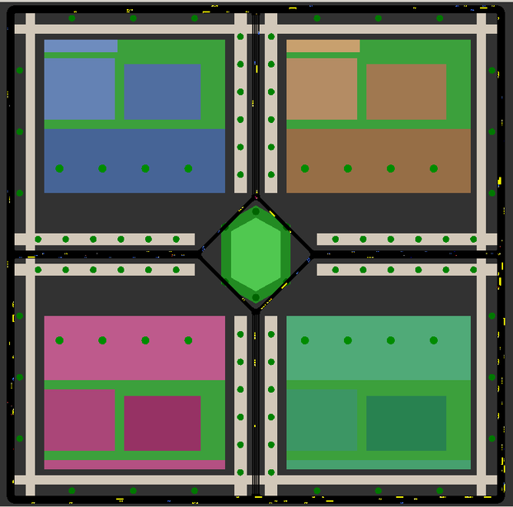
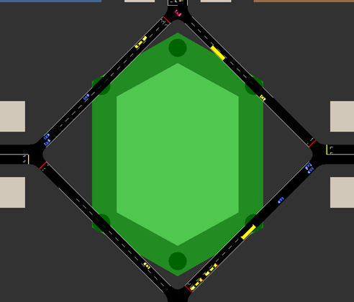

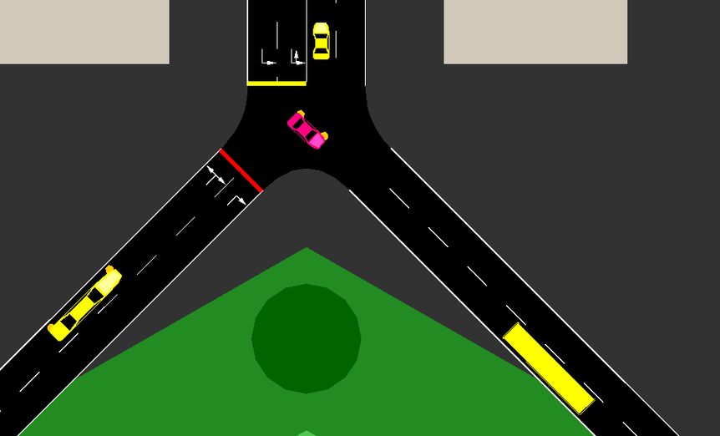


EXPERIMENTAL SETUP
Simulation Environment: Eclipse SUMO
  Simulator: Eclipse SUMO with TraCI real-time API.
  Traffic Injection: Dynamic, heterogeneous models (aggressive, passive, heavy transport).
  Deadlock Prevention: "Traffic Cop" routing script (forces 15s max signal phase).
  Sensor Emulation: Gaussian noise ( =0, cgf= 0.02) injected into kinematic arrays.
Traffic Signal
Ego Vehicle
Heterogeneous
Traffic
9

Slide 10
METHODOLOGY OVERVIEW
Overall System Architecture
  Complex Network Topology
  NPC vehicle flows
  Deterministic Fixed-Phase logic
SUMO SIMULATOR
TRAFFIC-LIGHT CONTROLLER
RL Policy Network (PPO / SAC — Actor-Critic, MLP)
Input: O_t (19-D)
  Output: Continuous Action a_t = [throttle/brake ∈ [-1, 1]]
Bi-directional socket link
TraCI INTERFACE
SIMULATION ENVIRONMENT LAYER
  forward progress along route
  speed-matching to target/limit
  potential-field collision penalty
  traffic-light-state awareness
R_velocity
R_progress
R_safety
Simulator
R_signal
  Reads ego (x,y)
  Maps to 5 Place Cells
  5-D place-cell vector
  Gaussian RBF activation
  Ego speed, heading
  Nearby vehicle positions
  Relative velocity
  Traffic-light phase state
  R_total = w1·R_progress + w2·R_velocity + w3·R_safety + w4·R_signal
BASAL GANGLIA DECISION ENGINE
HIPPOCAMPAL MODULE
RAW STATE EXTRACTOR
  traci.vehicle.setSpeed() / setAcceleration() applied to ego_0
  Simulation Step Advance → traci.simulationStep()
Concatenates:
[Place Cells (5) + Ego Kinematics (n) + Relative Vehicle Metrics (m) + Signal-State Encoding(k)] → 19-D Observation Vector O_t
ACTUATION / TRACI COMMAND LAYER
SENSOR FUSION MODULE
10
PERCEPTION & COGNITION LAYER

Slide 11
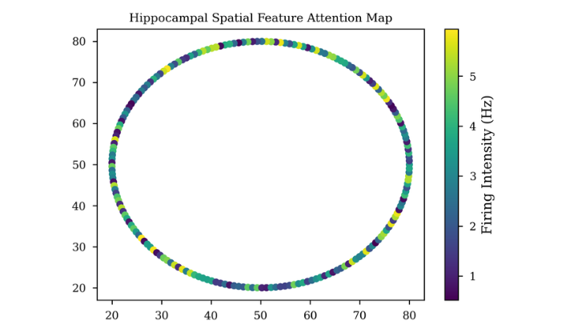
METHODOLOGY
Simulation Pipeline & Spatial Mapping
SUMO Environment & TraCI Layer
  Ground-truth vehicle physics engine
  Deterministic traffic-light control logic
  Continuous TraCI interface for real-time simulation control
Hippocampal Spatial Cognition Layer
  Maps continuous (x, y) coordinates to Place Cell activations
  Gaussian Radial Basis Function (RBF) encoding
  Output: 5-D Place Cell activation vector
11

Slide 12
METHODOLOGY
State Construction & Actor-Critic Architecture
Sensor Fusion & State Construction
Place Cells
Ego Kinematics
Vehicle Metrics
Traffic Signals
  Concatenates 5-D Place Cells + ego kinematics
  Adds relative vehicle metrics + traffic-signal states
  Output: normalized 19-D Observation Vector
Sensor Input
19-D Vector
Basal Ganglia Decision Engine (Algorithmic Progression)
Critic Network
Value Q
  Two-Phase Actor-Critic Implementation:
  Phase 1 Baseline: Proximal Policy Optimization (On-Policy)
  Phase 2 Solution: Soft Actor-Critic (Off-Policy + Max Entropy)
  Biologically-inspired action-gating mechanism
  Continuous throttle / brake output ∈ [-1, 1]
Value Estimate
Actor Network Policy π
Action Output Throttle/Brake
12

Slide 13
METHODOLOGY
Reward Optimization & ROS 2 Integration
Composite Reward Shaping
Weighted sum of four reward components:
SAC Policy Node
  Forward Progress
  Velocity Matching
  Safety Potential Fields
  Signal Awareness
  /ego_state
/cmd_vel
Composite Reward = α·Progress + β·Velocity + γ·Safety + δ·Signal
ROS 2 Deployment Bridge
  Bridges the trained policy to ROS 2 middleware
  Publishes control commands as ROS 2 topics
  Establishes the sim-to-real deployment pathway
SUMO TraCI Node
13

Slide 14
RECENT UPDATES
Infinite-Horizon Routing & “Traffic Cop”
Deadlock Resolution (“Traffic Cop”)
Infinite-Horizon Routing
3
1
Dynamic Traffic Injection
TraCI script auto-deletes background vehicles lagging >12 s and forces a 15 s max signal-phase cap to prevent gridlock.
TraCI dynamically recalculates target exits — eliminates artificial episode truncations.
2
Sinusoidal probability models simulate heavy rush-hour traffic with heterogeneous profiles (aggressive cars, heavy trucks, erratic drivers).
14

Slide 15
ROBUSTNESS
Sim-to-Real Robustness: Gaussian Noise Injection
Noise Injection
Robustness Testing
1
3
Gaussian noise (mean = 0, std = 0.02) injected into kinematic sensor arrays.
Sensor Emulation
Validates policy stability under imperfect, noisy sensor readings.
2
Emulates real-world LiDAR / camera inaccuracies during training.
15

Slide 16
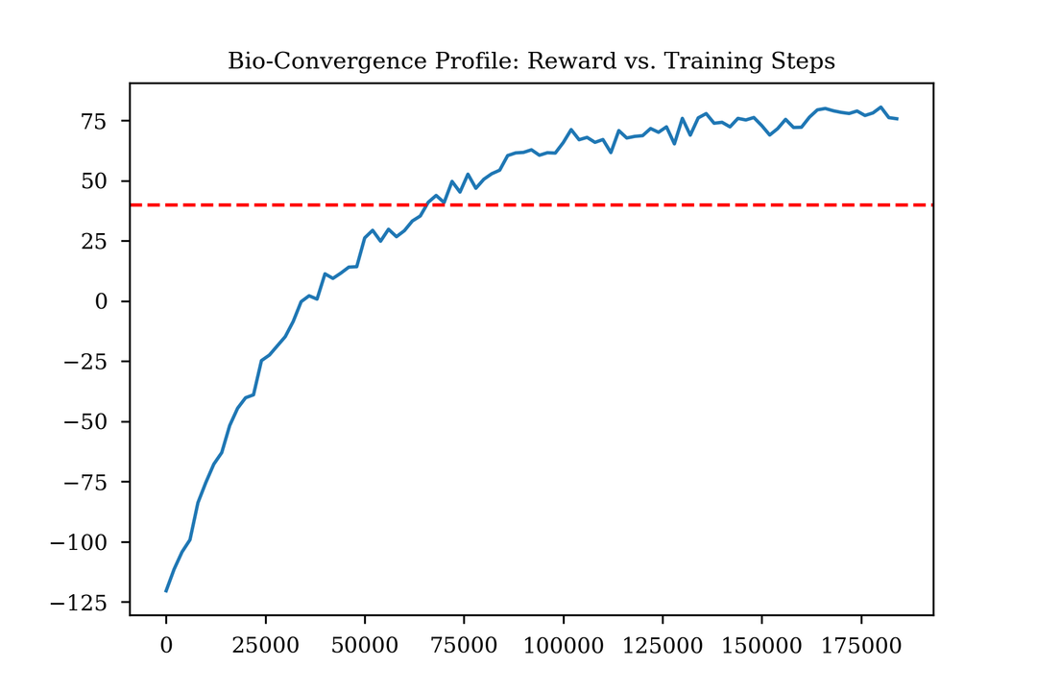
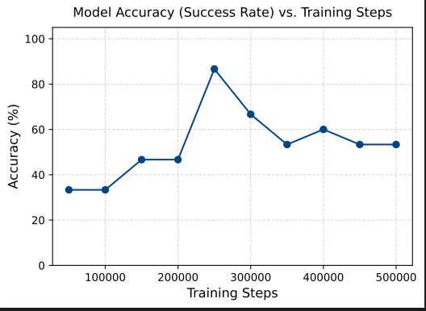
ROBUSTNESS
Phase 1 Results: PPO Learning Trajectory & Policy Collapse
  Initial learning was highly successful, peaking at an optimal 86.7% navigation success rate at 250,000 steps.
  Prolonged exposure to Gaussian sensor noise triggered catastrophic forgetting.
  By 500,000 steps, success plummeted to ~53%, despite cumulative reward artificially plateauing due to local-optima exploitation (halting to avoid collisions).
16

Slide 17
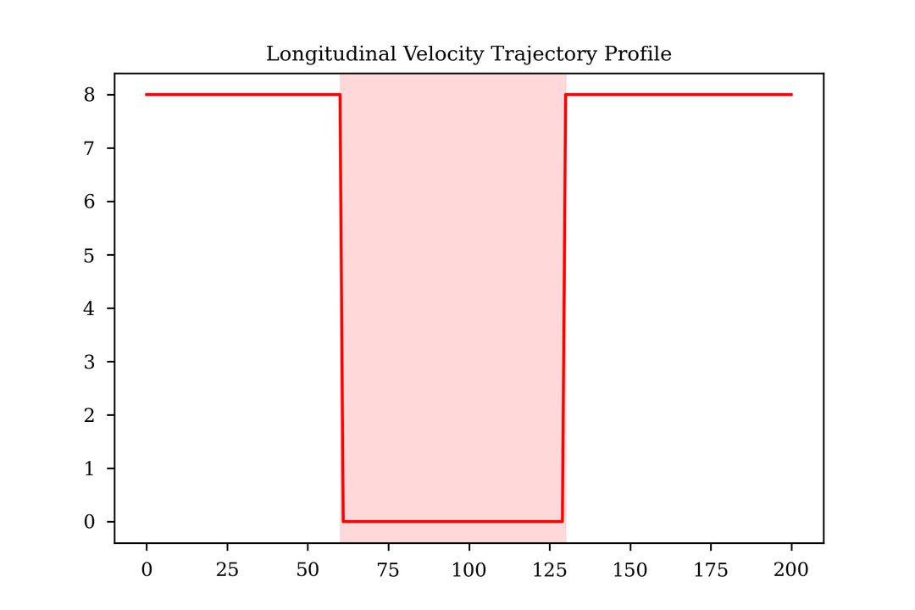
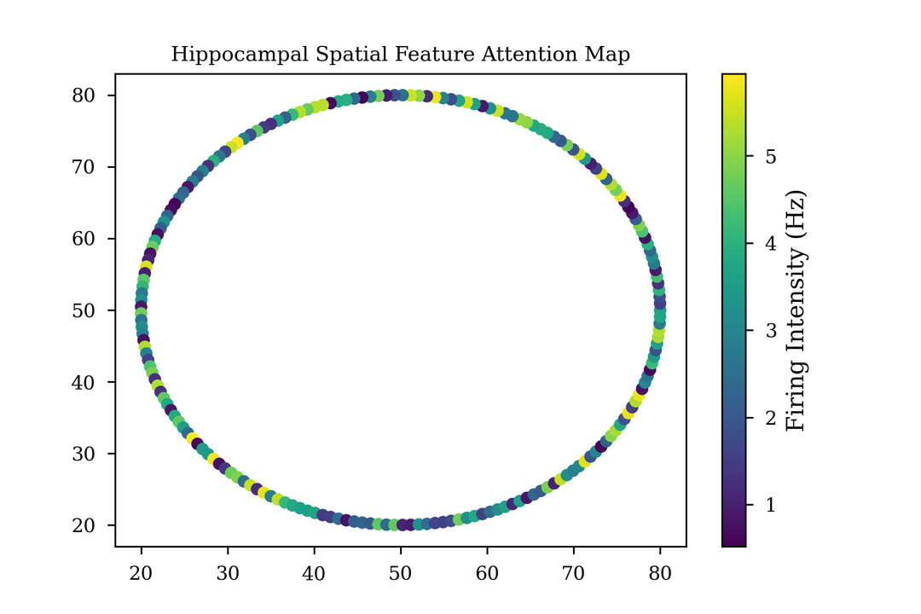
EVALUATION
Phase 1 Findings: Behavioral Anomalies Under Noise
  Velocity Paralysis: Trajectory profile exhibits a severe anomaly, with velocity instantaneously dropping from 8 m/s to 0 m/s, leaving the agent paralyzed on the track for over 60 timesteps.
  Spatial Hallucination: The Hippocampal heatmap displays erratic "salt-and-pepper" noise instead of cohesive spatial confidence. The agent's spatial awareness shattered, directly causing the emergency braking anomaly.
17

Slide 18
STATUS
Current Status & Transition to Phase 2
1/4
2/4
Completed (Phase 1): PPO baseline established and evaluated — brittle to biological spatial mapping under continuous Gaussian noise.
  In Progress (Phase 2): Transitioning to Soft Actor-Critic (SAC).
LIVE DEMO READY
Ego vehicle continuously navigating high-density traffic in the SUMO GUI — without episode resets.
3/4
4/4
  The SAC Solution: Experience Replay Buffer breaks temporal noise correlation; Maximum-Entropy framework prevents the deterministic paralysis seen in PPO.
  Live Status: SAC agent actively training in the SUMO environment.
18

Slide 19
References
[1] Y. Liao et al., "A brain-inspired framework integrating Entorhinal-Hippocampal-Prefrontal circuits for adaptive navigation in mobile robots," Electronic Research Archive, 2026.
[2] D. Pedamonti et al., "Hippocampus supports multi-task reinforcement learning under partial observability," IEEE Transactions on Intelligent Transportation Systems, 2025.
[3] J. Choi & S. Kim, "Predictive Risk-Aware Reinforcement Learning for Autonomous Vehicles Using Safety Potential," Nature Communications, 2025.
[4] Z. Lin et al., "Hierarchical Multi-Agent MCTS for Safety-Critical Coordination in Mixed-Autonomy Roundabouts," IEEE Transactions on Vehicular Technology, 2026.
[5] J. Jin et al., "Hybrid action space approach to traffic signal optimization using deep reinforcement learning," Computers & Operations Research, 2026.
19
BASAL GANGLIA DECISION ENGINE

Slide 20

Thank You
AM.AI.U4AID23042 — Harita Aneesh · AM.AI.U4AID23059 — Sheron George · Guide: Dr. Divya Udayan J

